Slide 1
Car Mileage Decision Trees
Evan Casey - Potter 4B
Notes:
2 most valuable things? Time and money. People get so up in arms about gas prices because those costs really add up. A cars mileage is what determines how much gas you need to purchase, and has a partial say in how often you need to inconvenience og getting gas

Slide 2
Can we use decision trees to predict a cars approx. mileage through certain specs such as make, year, fuel type, etc?
Notes:
Brands often lie or inflate numbers, so we need to determine our own way to estimate car mileage with information readily available

Slide 3
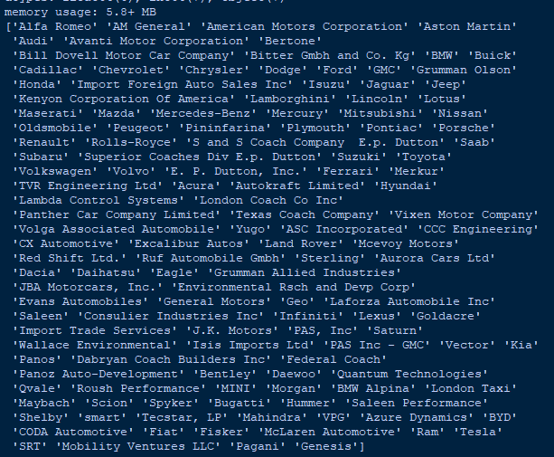
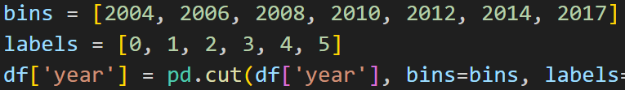
The Dataset
City road mileage | Target (9 uniques)
Year | 6 uniques
Make | 11 uniques
Drive | 7 uniques
Engine cylinders | 8 uniques
Engine displacement | 13 uniques
Fuel type | 11 uniques
Started with MANY useless columns
Some columns were unfair to include
Tens of thousands of rows
Used label encoding to group values
Notes:
Bill dovell?

Slide 4
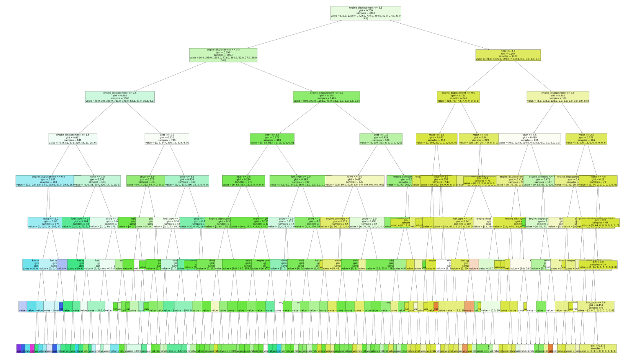
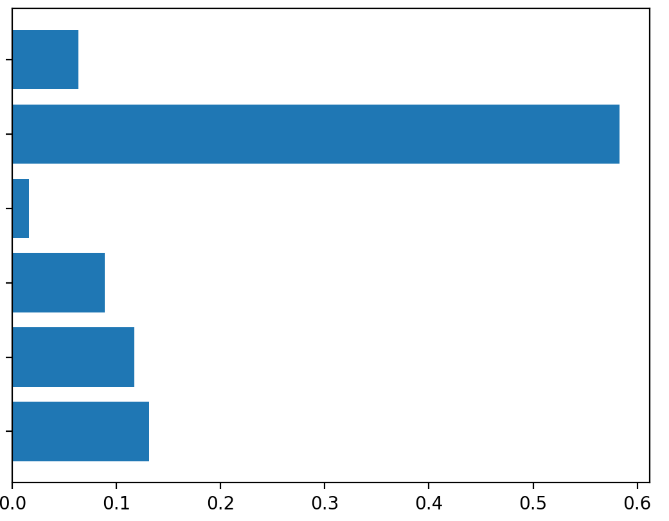
The Tree
Attribute Importance
fuel type
displacement
cylinders
drive
make
year
natural depth = 15, artificial depth=8

Slide 5
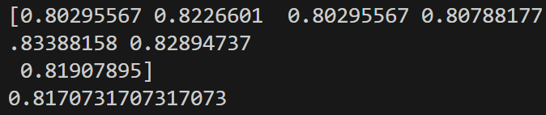

Results and Boosters
Raw Results
ADA ““boost””
Bagging boost
Avg score of 81%
Went down to 75% when max depth was reduced to 8 for graph simplicity
Avg score of 50%
Changing N and learning rate parameters did not change score by more than 1%
Avg score of 83%
Peaked at n_estimator of 15
Higher values got less accurate and took longer to process

Slide 6
Retrospect
Odd importance:
-fuel type negligible
-engine displacement heavily weighted
If I could do it again:
-include electric vehicles
-average city/highway mileage for more realistic mileage
Could be improved with more features, more gentle rounding, more recent data

Slide 7
Thanks!
Questions?

